Slide 1
Understanding Users
The Heart of User-Centered Design

Slide 2
Agenda
User-Centered Design Principles
Creating User Personas
Conducting User Research
Importance of Empathy in Design

Slide 3

User-Centered Design Principles
Focus on the End User
Involve Users Throughout the Design Process
Prioritize Usability and Accessibility
Iterate and Refine Based on User Feedback

Slide 4
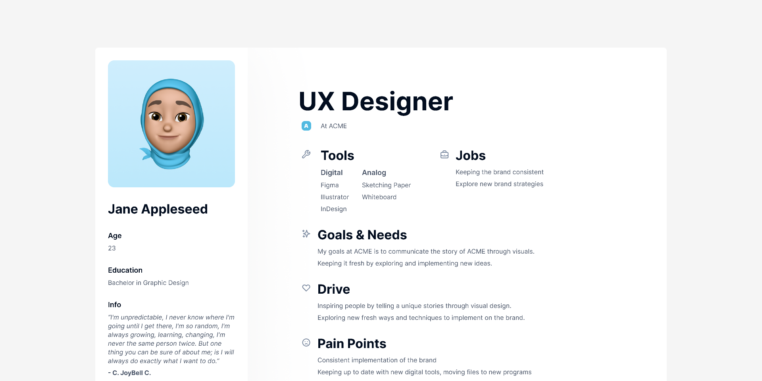
Creating User Personas
User Personas
Think of user personas as make-believe friends who represent the typical users of your product. These imaginary characters help us make smart design choices.
Key Components
Who they are:- Include things like age, job, and where they live.
What they want:- Think about their goals and what they hope to achieve.
What's tough for them:- Consider any problems or challenges they might face.
How they behave:- Understand how they usually use products or services.

Slide 5
Why User Personas Matter
Human-Centered Design
User personas keep our focus on real people, making our designs more helpful and user-friendly.
Smart Decision Making
They help us make good choices by understanding what our imaginary friends need and like.
Easy Communication
User personas make it easy for everyone in the team to talk about and understand our users.
Friendship with Users
These personas are like advocates for real users, making sure we think about their needs and not just what we assume.
Problem Solving
They help us solve problems before they happen by thinking about what might be tricky for our imaginary friends.

Slide 6
Creating Effective User Personas
Research-Driven
Make these imaginary friends based on real information we find out from talking to real people.
Keep it Real
Make sure our imaginary friends feel like real people, so they really help us understand users.
Stay Updated
Check in on our imaginary friends regularly, just like catching up with real friends.
Share the Love
Tell everyone in the team about our imaginary friends so we all think about users when we design.

Slide 7

Meet "Alex"
Who they are
Age: 23
Job: Graphic Designer
Location: Biratnagar
What they want
Make designing easier and keep up with the latest trends.
What's tough for them
Limited time for personal projects and struggles with learning new design tools.
How they behave
Prefers using design tools on a phone and likes joining design webinars.

Slide 8

Conducting User Research
Types of User Research (Surveys, Interviews, Observations)
Gathering Data
Analyzing and Synthesizing Findings

Slide 9
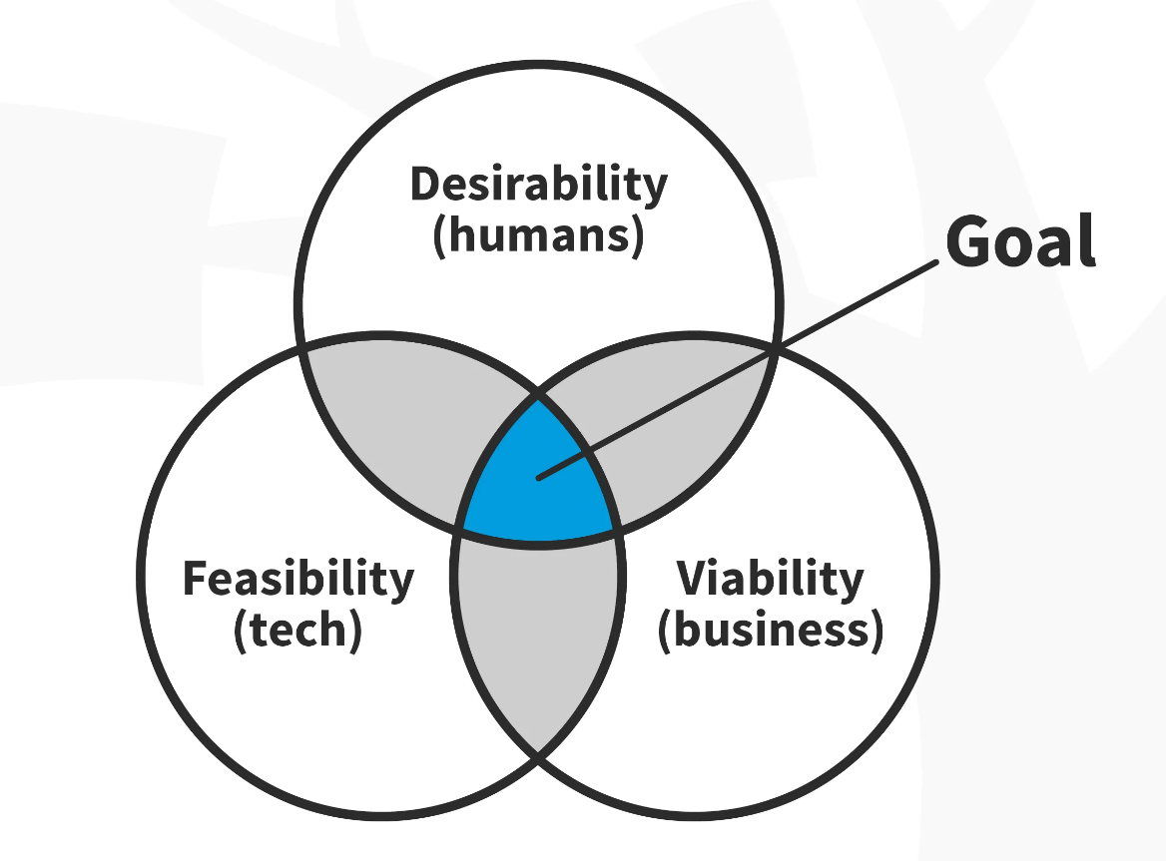
Importance of Empathy in Design
Understanding User Perspectives
Designing with Empathy Enhances User Experience
Real-Life Examples of Empathetic Designs

Slide 10
Questions and Discussion
Any Question ?

